Slide 1
NS-3 Exp1: raise threshold of s4 to 100KB
r₁ = B
S1
L1
S2
Flow 1
tx
rx
PFC Threshold of RX in S4
= 100 KB
rx
tx
L4
L2
r₂ = B
tx-1
L3
rx
S4
S3
Flow 2
tx-2
rx
tx
Link delay = 0.001ms, link capacity = 40Gbps
All Other PFC Threshold = 40 KB, Deadlock does not happen.

Slide 2
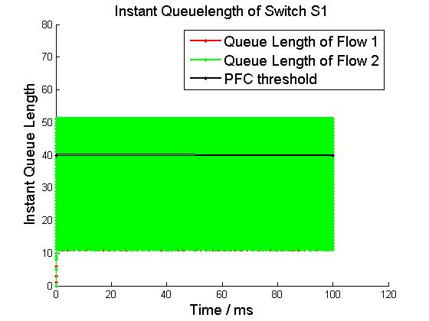
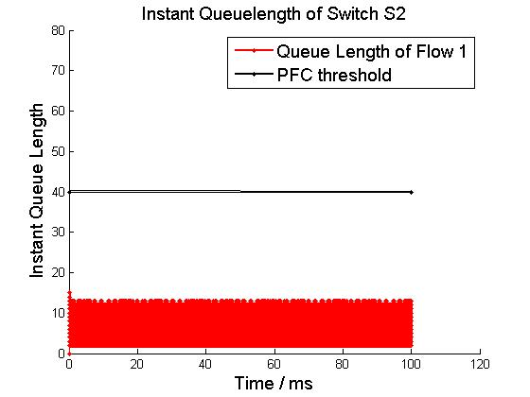
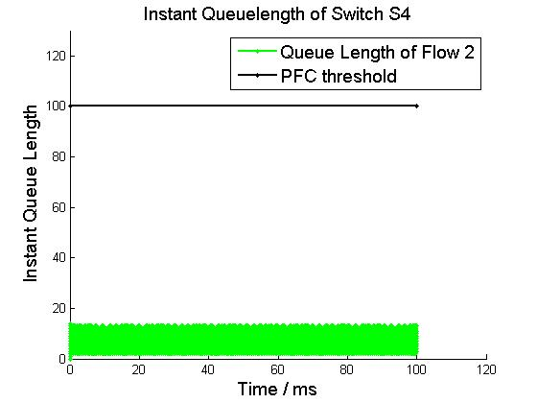
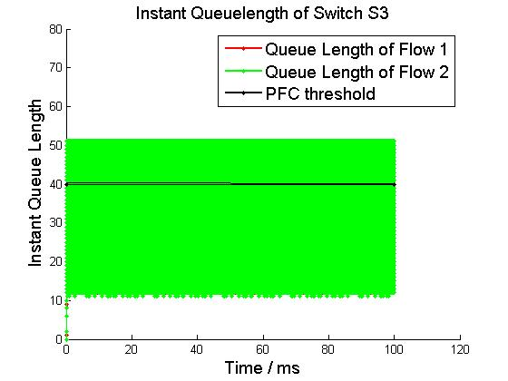
Buffer Occupation
r₁ = B
S1
L1
S2
Flow 1
tx
rx
rx
tx
L4
L2
r₂ = B
tx-1
L3
rx
S4
S3
Flow 2
tx-2
rx
tx

Slide 3
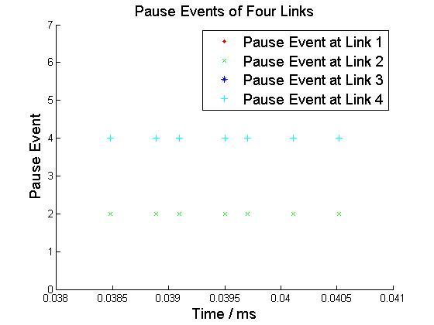
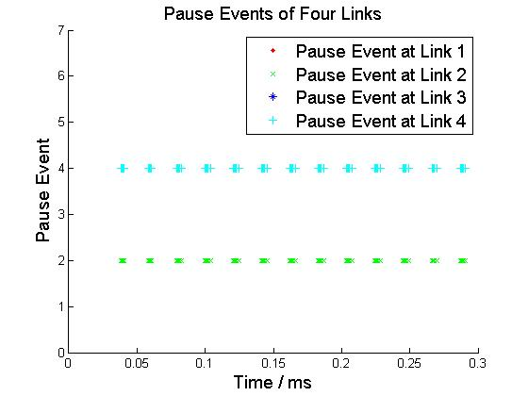
Pause Pattern
Micro View
Macro View

Slide 4
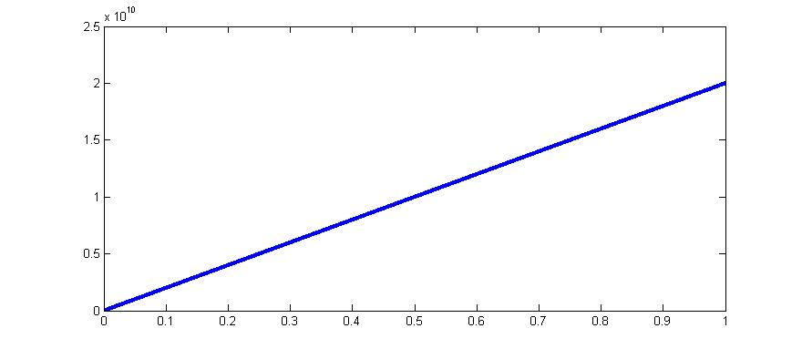

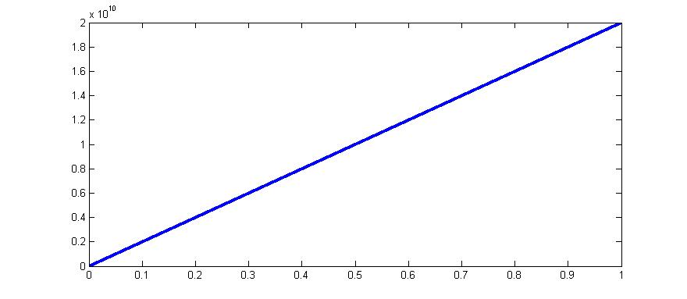








Matlab Exp1: raise threshold of s4 to 100KB
$$s_{f}^{1}(t)$$
$$s_{f}^{2}(t)$$
$$s_{f}^{3}(t)$$
$$s_{f}^{4}(t)$$
$$s_{g}^{1}(t)$$
$$s_{g}^{2}(t)$$
$$s_{g}^{3}(t)$$
$$s_{g}^{4}(t)$$
Deadlock does not happen

Slide 5
Exp2: drop s4 threshold till the highest value at which deadlock forms
NS-3 results:
link delay = 1us
Threshold of S4 | 10KB | 11KB | 12KB | 13KB | 15KB
Deadlock | yes | yes | no | no | no
*11KB is the highest queue occupancy that flow 2 can achieve at switch S4 when threshold is set to a value larger than 11KB.
link delay = 0us
Threshold of S4 | 1KB | 2KB | 3KB | 4KB | 10KB
Deadlock(link delay =0us) | no | no | no | no | no
Matlab results:
Threshold of S4 | 1KB | 2KB | 3KB | 4KB | 10KB
Deadlock | no | no | no | no | no

Slide 6
NS-3 Exp3: for 1K threshold at s3, plot PFC events
r₁ = B
S1
L1
S2
Flow 1
tx
rx
rx
tx
PFC Threshold of RX in S3
= 1 KB
L4
L2
r₂ = B
tx-1
L3
rx
S4
S3
Flow 2
tx-2
rx
tx
Link delay = 0.001ms, link capacity = 40Gbps
All Other PFC Threshold = 40 KB, Deadlock does not happen.

Slide 7
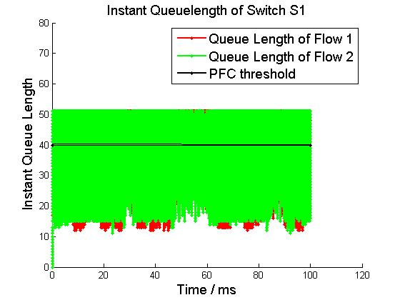
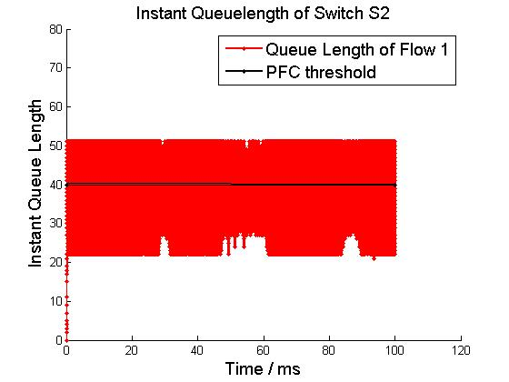
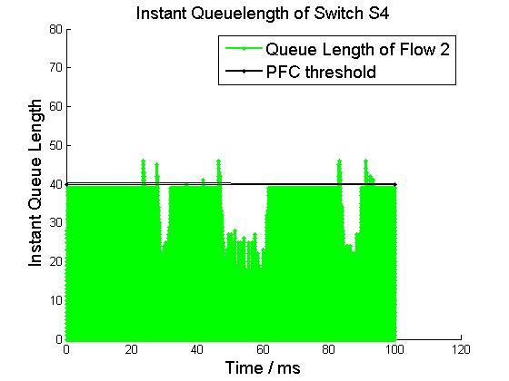
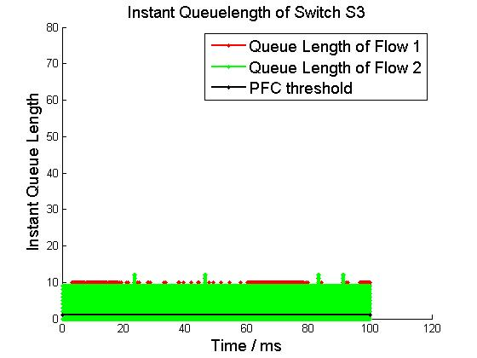
Buffer Occupation
r₁ = B
S1
L1
S2
Flow 1
tx
rx
rx
tx
L4
L2
r₂ = B
tx-1
L3
rx
S4
S3
Flow 2
tx-2
rx
tx

Slide 8
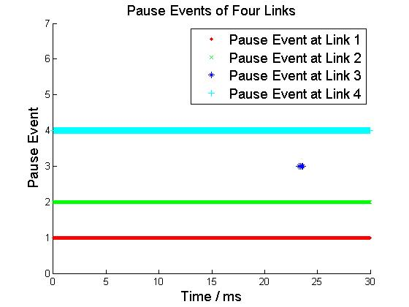
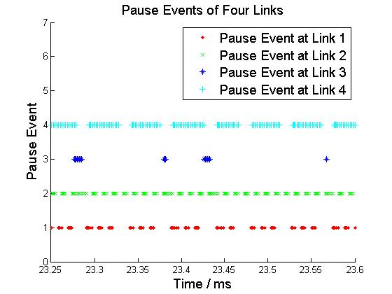
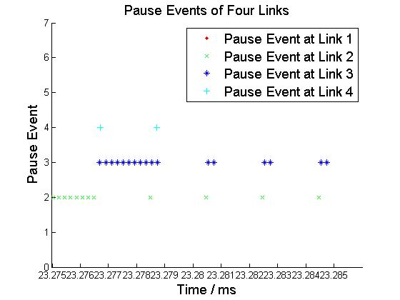
Pause Pattern
Macro View
Micro View
Micro View

Slide 9
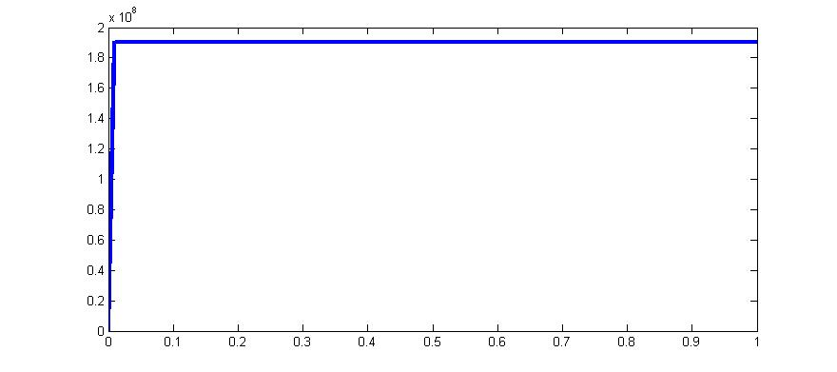
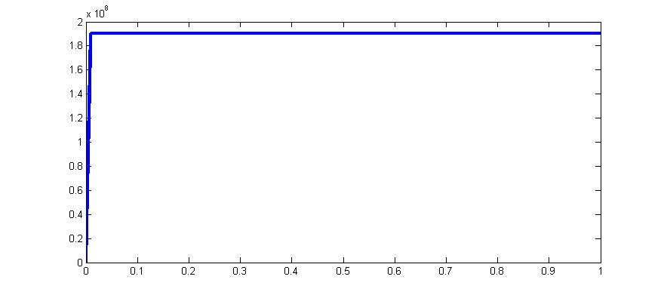

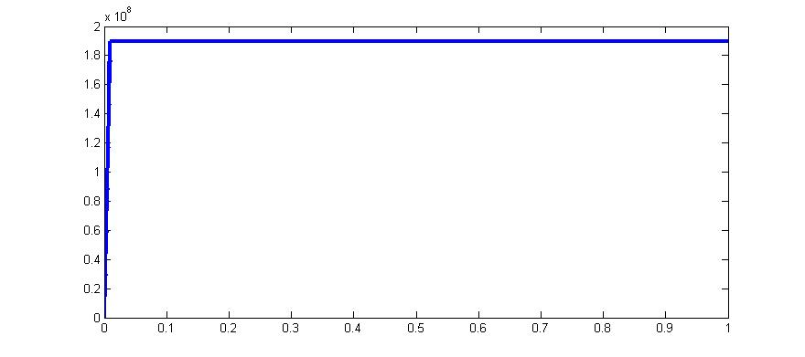







Matlab Exp3: for 1K threshold at s3, plot PFC events
$$s_{f}^{1}(t)$$
$$s_{f}^{2}(t)$$
$$s_{f}^{3}(t)$$
$$s_{f}^{4}(t)$$
$$s_{g}^{1}(t)$$
$$s_{g}^{2}(t)$$
$$s_{g}^{3}(t)$$
$$s_{g}^{4}(t)$$
Deadlock happens under fluid model.
When link delay =0us, NS-3 simulation also has deadlock.

Slide 10
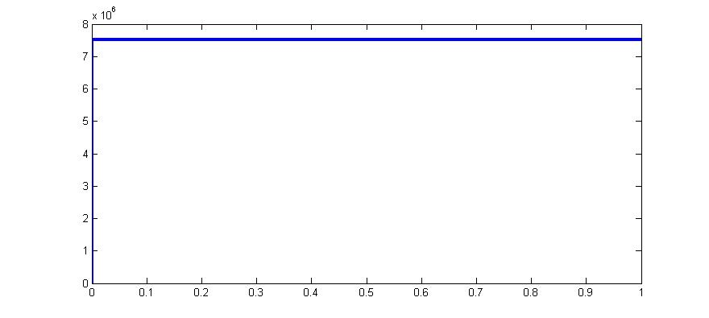
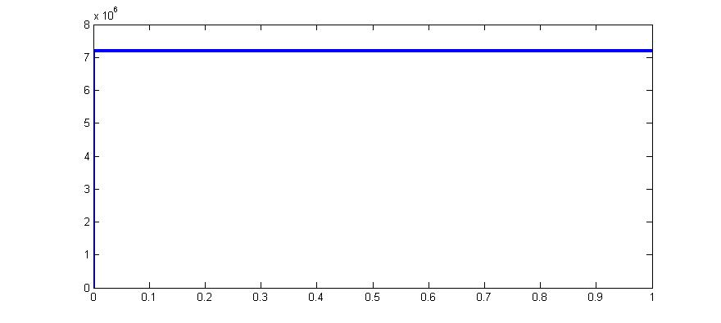
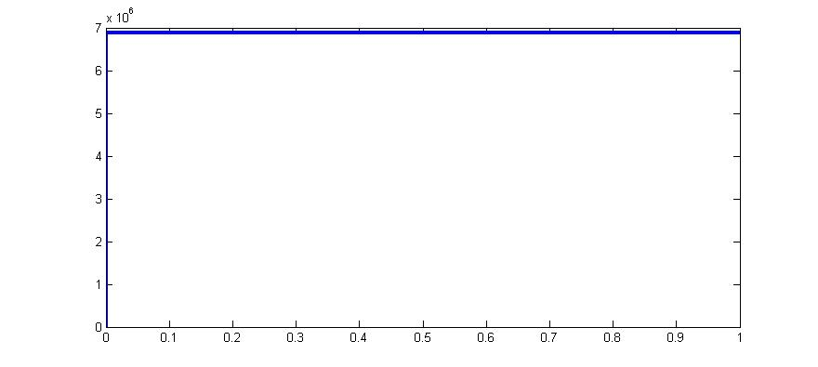









Matlab Exp4: 3-switch 3-flow scenario
$$s_{f}^{1}(t)$$
$$s_{f}^{2}(t)$$
$$s_{f}^{3}(t)$$
$$s_{g}^{1}(t)$$
$$s_{g}^{2}(t)$$
$$s_{g}^{3}(t)$$
$$s_{h}^{1}(t)$$
$$s_{h}^{2}(t)$$
$$s_{h}^{3}(t)$$
Deadlock happen

